Slide 1

CSC 342/343 Take Home Test 3
By
Ben variano
For
Professor Gertner
Fall 2019

Slide 2
Objective
The objective of this take home test is to gain a better understanding of vector instructions
We do so through the use of vector instructions to compute the dot product of two matrices

Slide 3
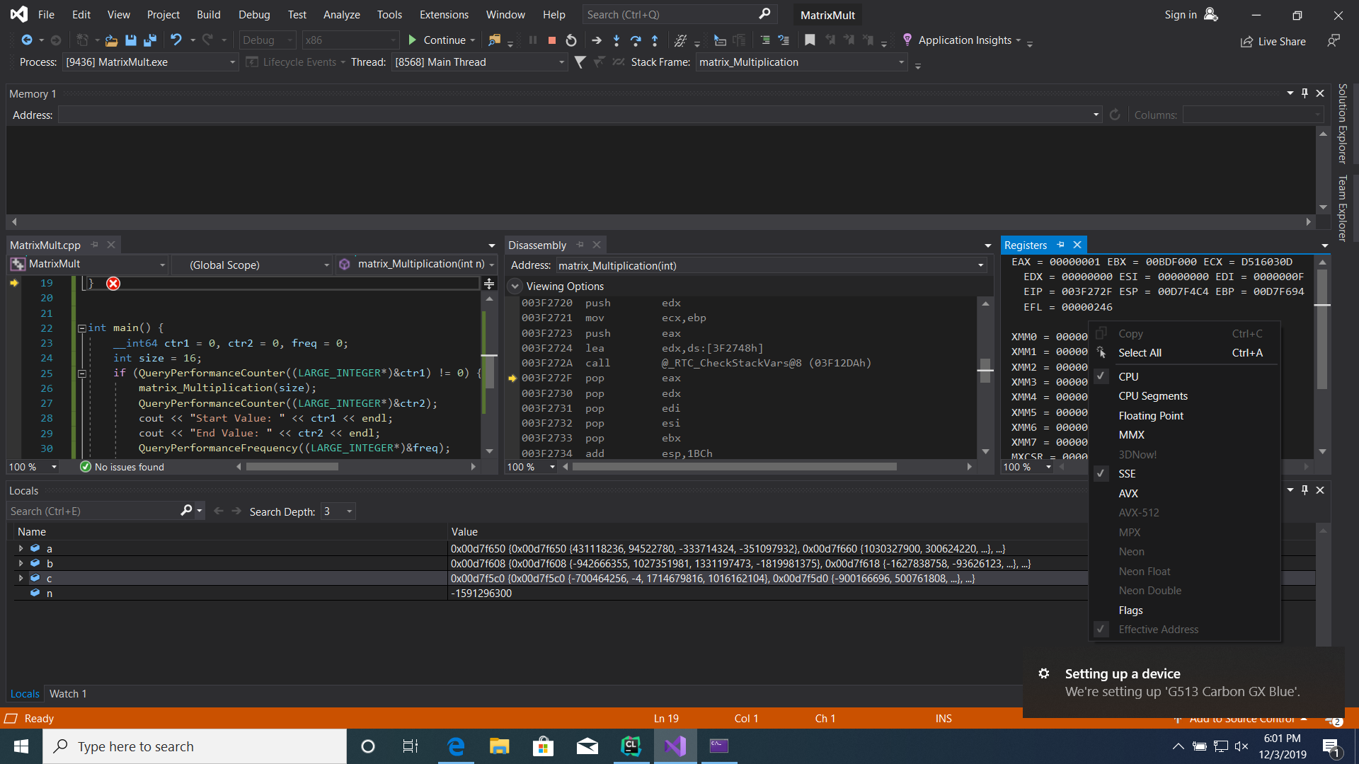
CPUID
It is clear from the screenshot, that the computer I am running is capable of SSE vector processing

Slide 4
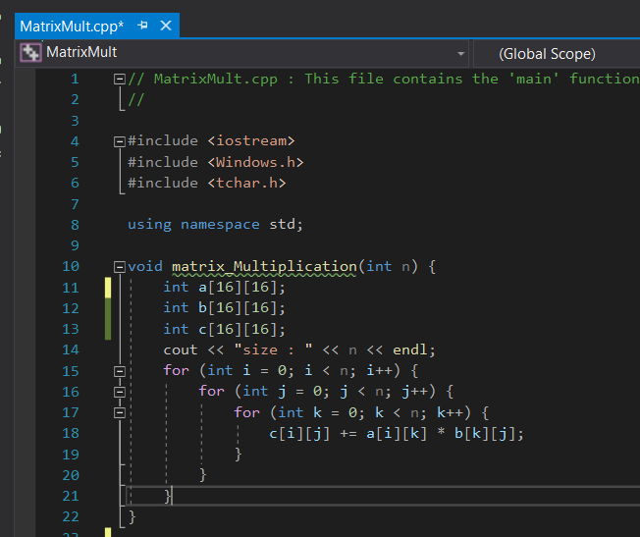
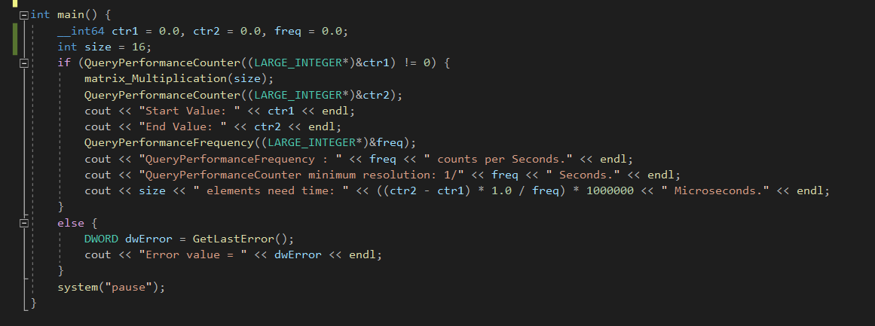
C++ code for dot product in Visual Studio Environment

Slide 5
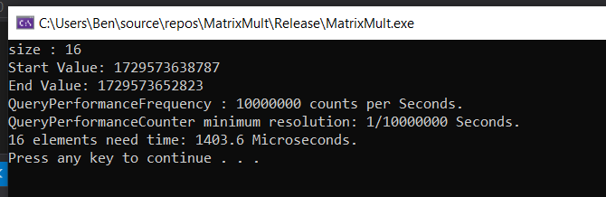
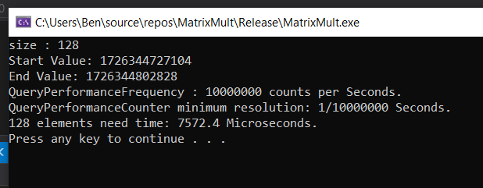


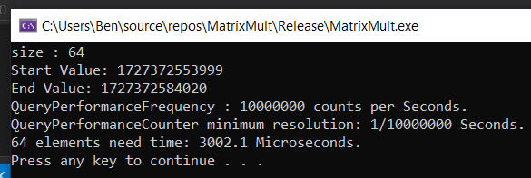
Dot Product with Automatic Parallelization and Vectorization Disabled

Slide 6
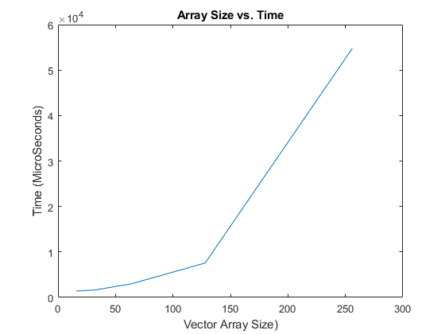
Dot Product with Automatic Parallelization and Vectorization Disabled

Slide 7
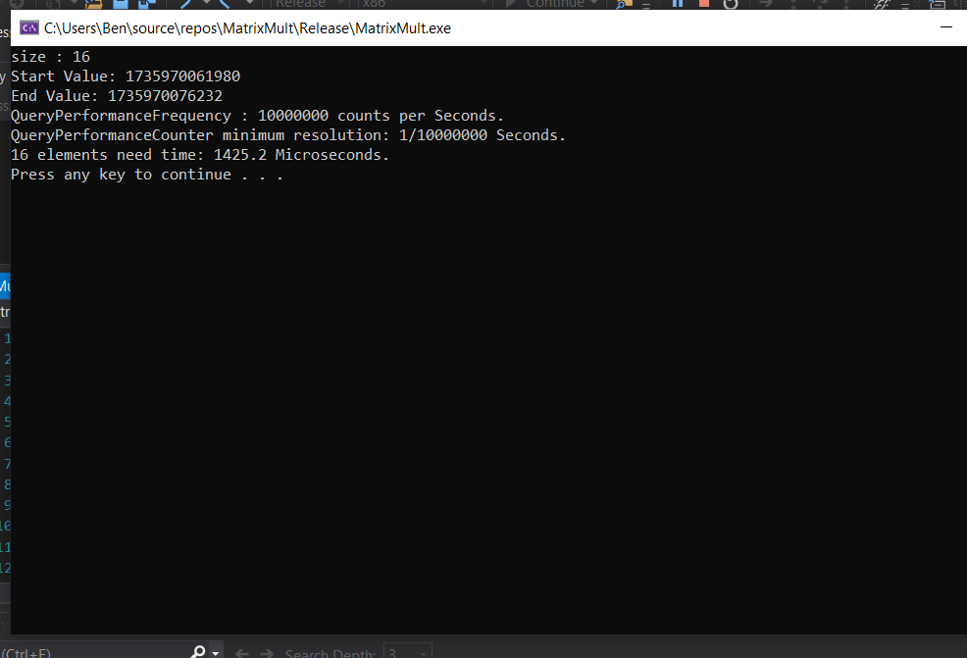
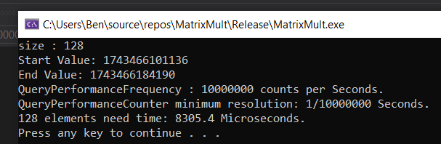
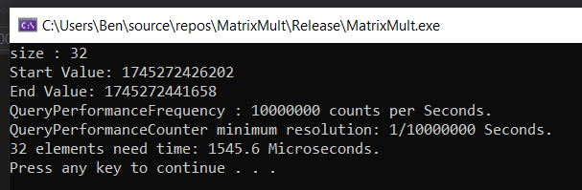


Dot Product with Automatic Parallelization and Vectorization Enabled

Slide 8
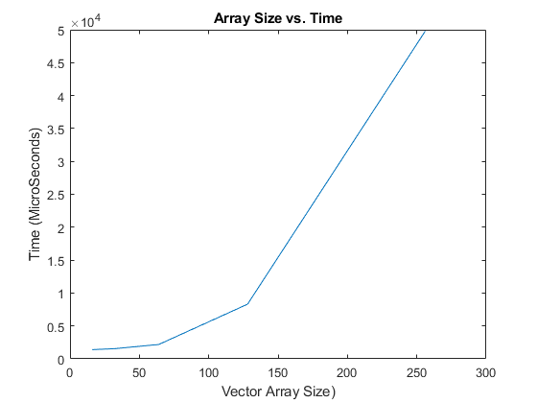
Dot Product with Automatic Parallelization and Vectorization Enabled

Slide 9
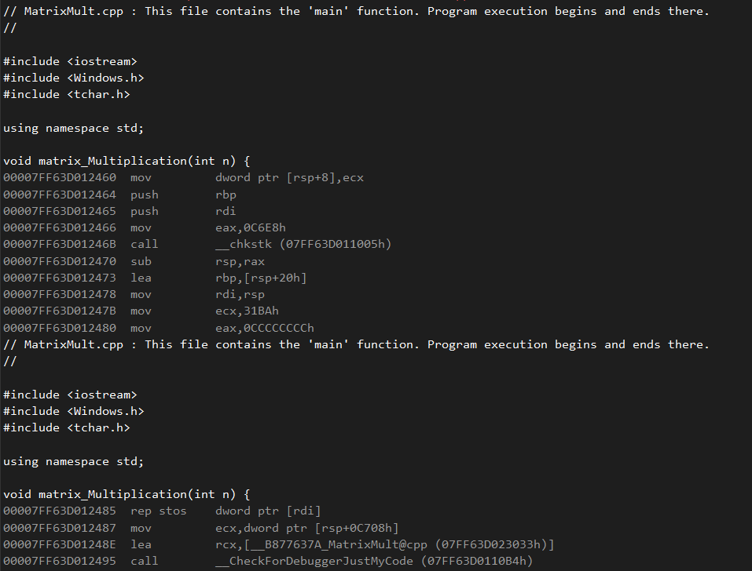
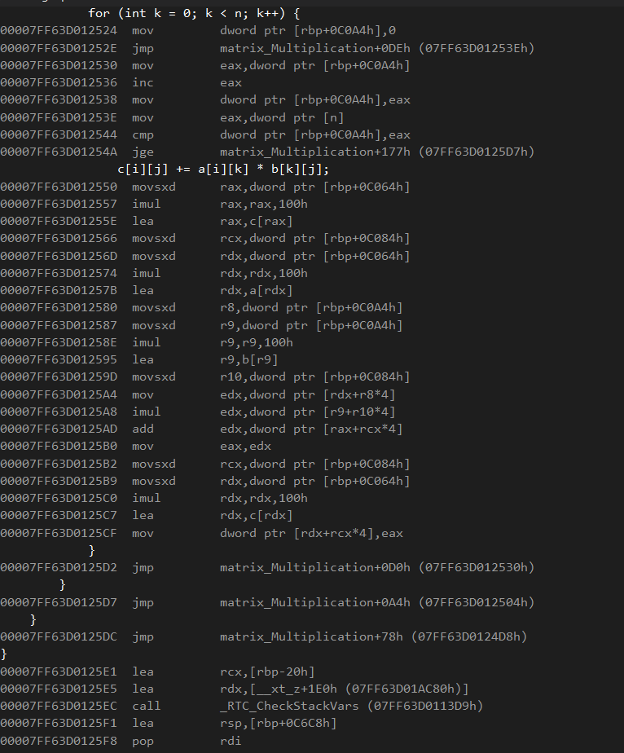
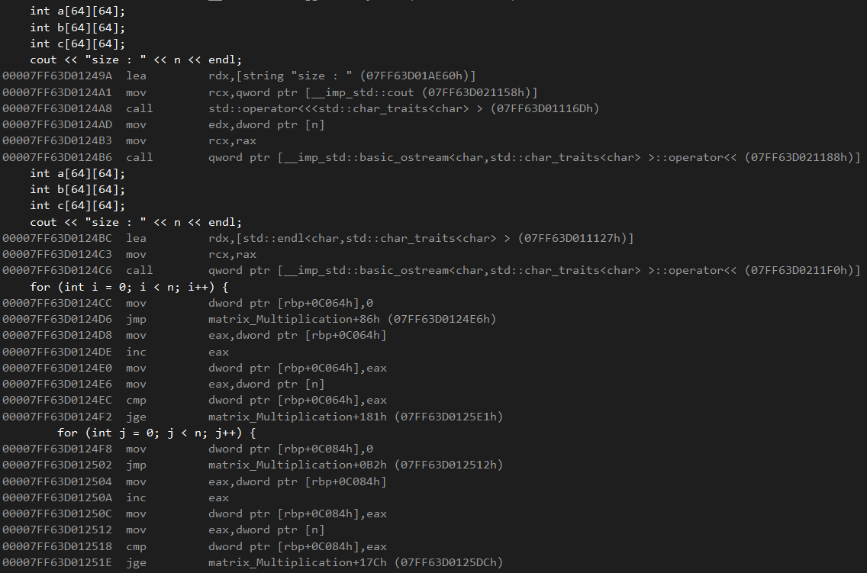
Assembly Code For Dot Product

Slide 10
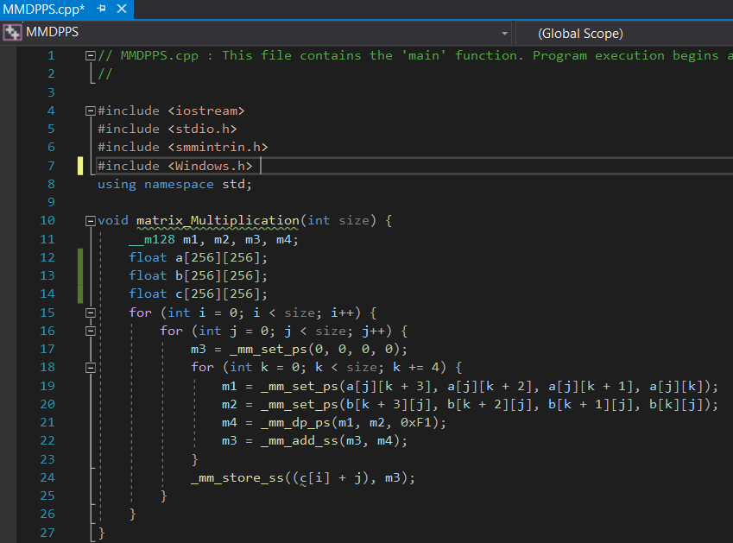
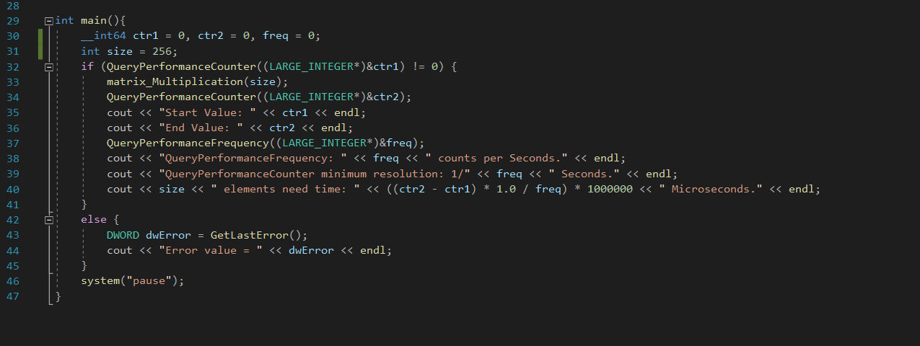
C++ Code Using DPPS for Dot Product in Visual Studio Environment

Slide 11


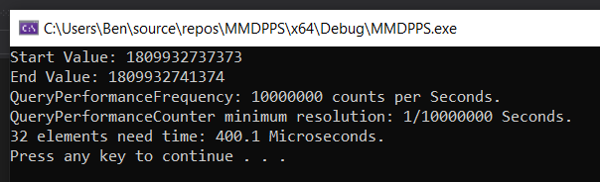
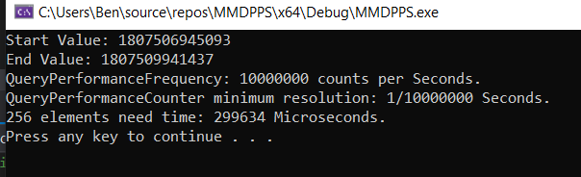

Dot Product Using DPPS Vector Instruction

Slide 12
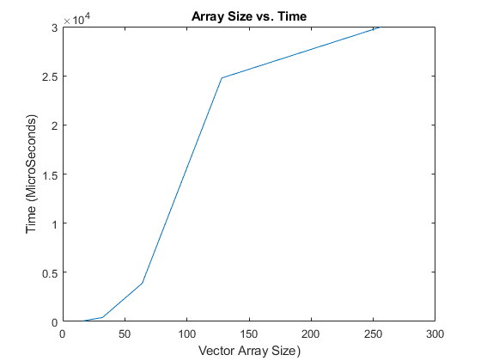
Dot Product Using DPPS Vector Instruction

Slide 13
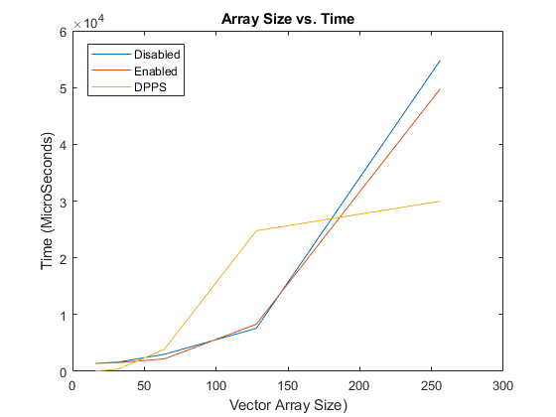
All Plots for Time vs. Vector size Combined

Slide 14
Conclusion
In conclusion, it is clear to see the benefit of using vector instructions when computing the dot product.
Using them speeds up the time for computation compared to having them disabled
We then go even further and can optimize the assembly or use intrinsic DPPS functions to speed up the computations again, all making for a more efficient machine

Slide 15
Thank you for listening

